Slide 1
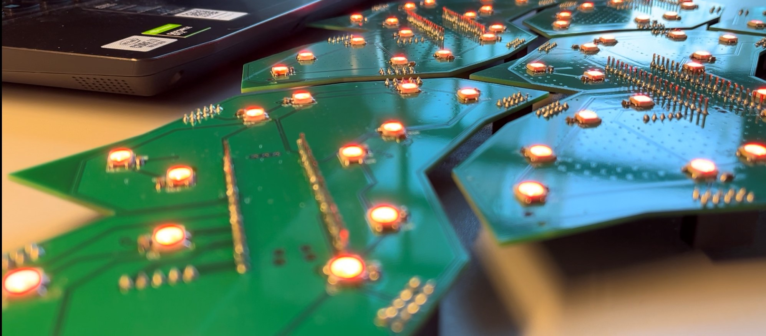

Lannooleaf
Projectweek 2022 - Sprint 4

Slide 2
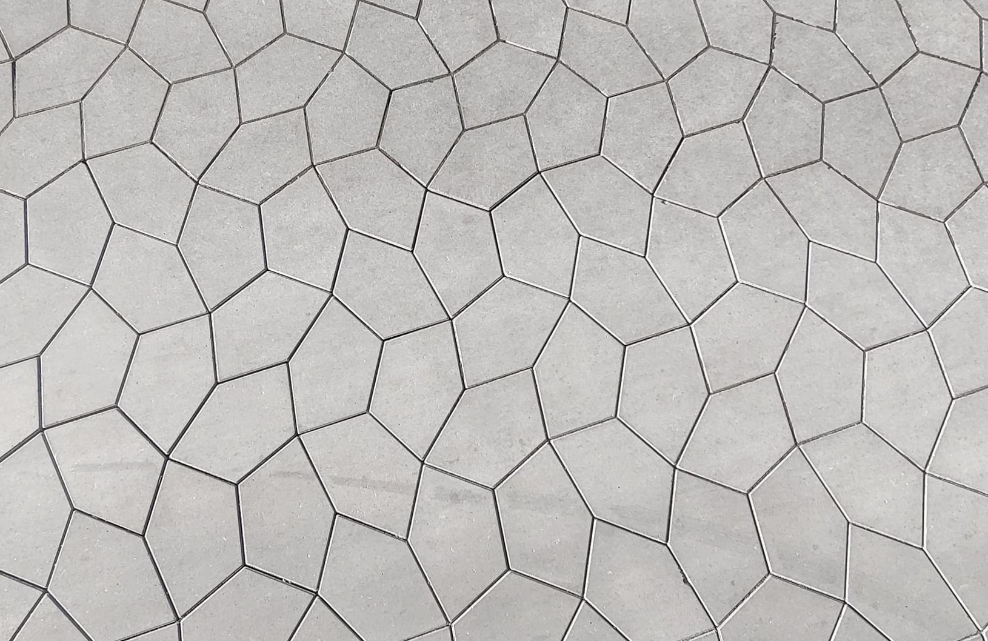
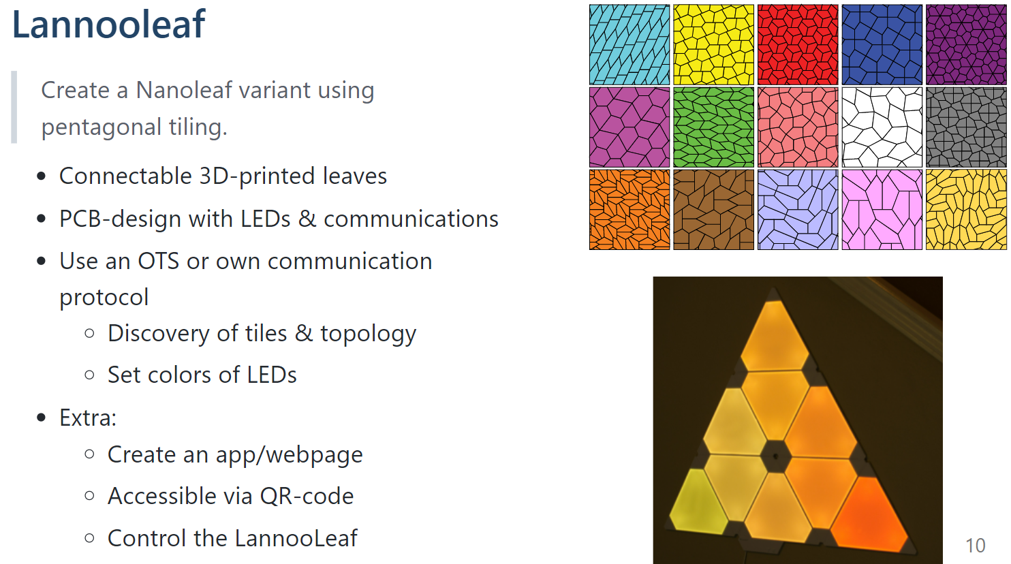
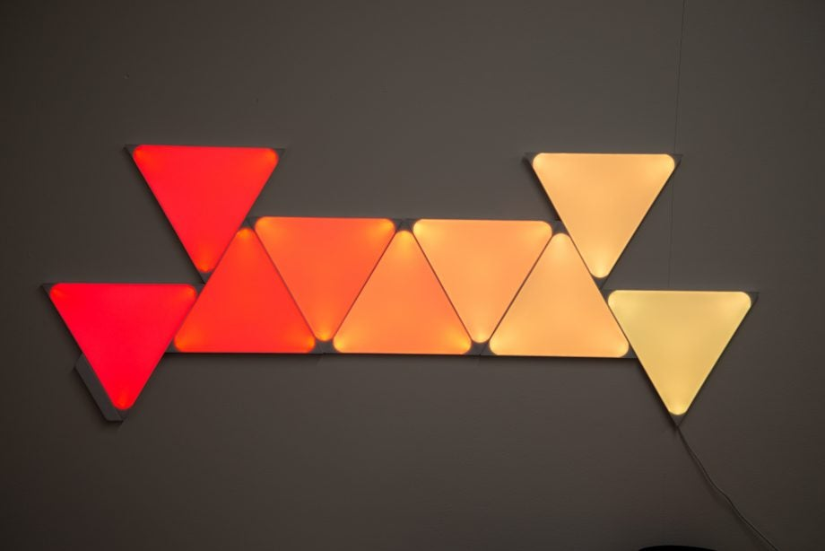
Lannooleaf
Problem Statement

Slide 3
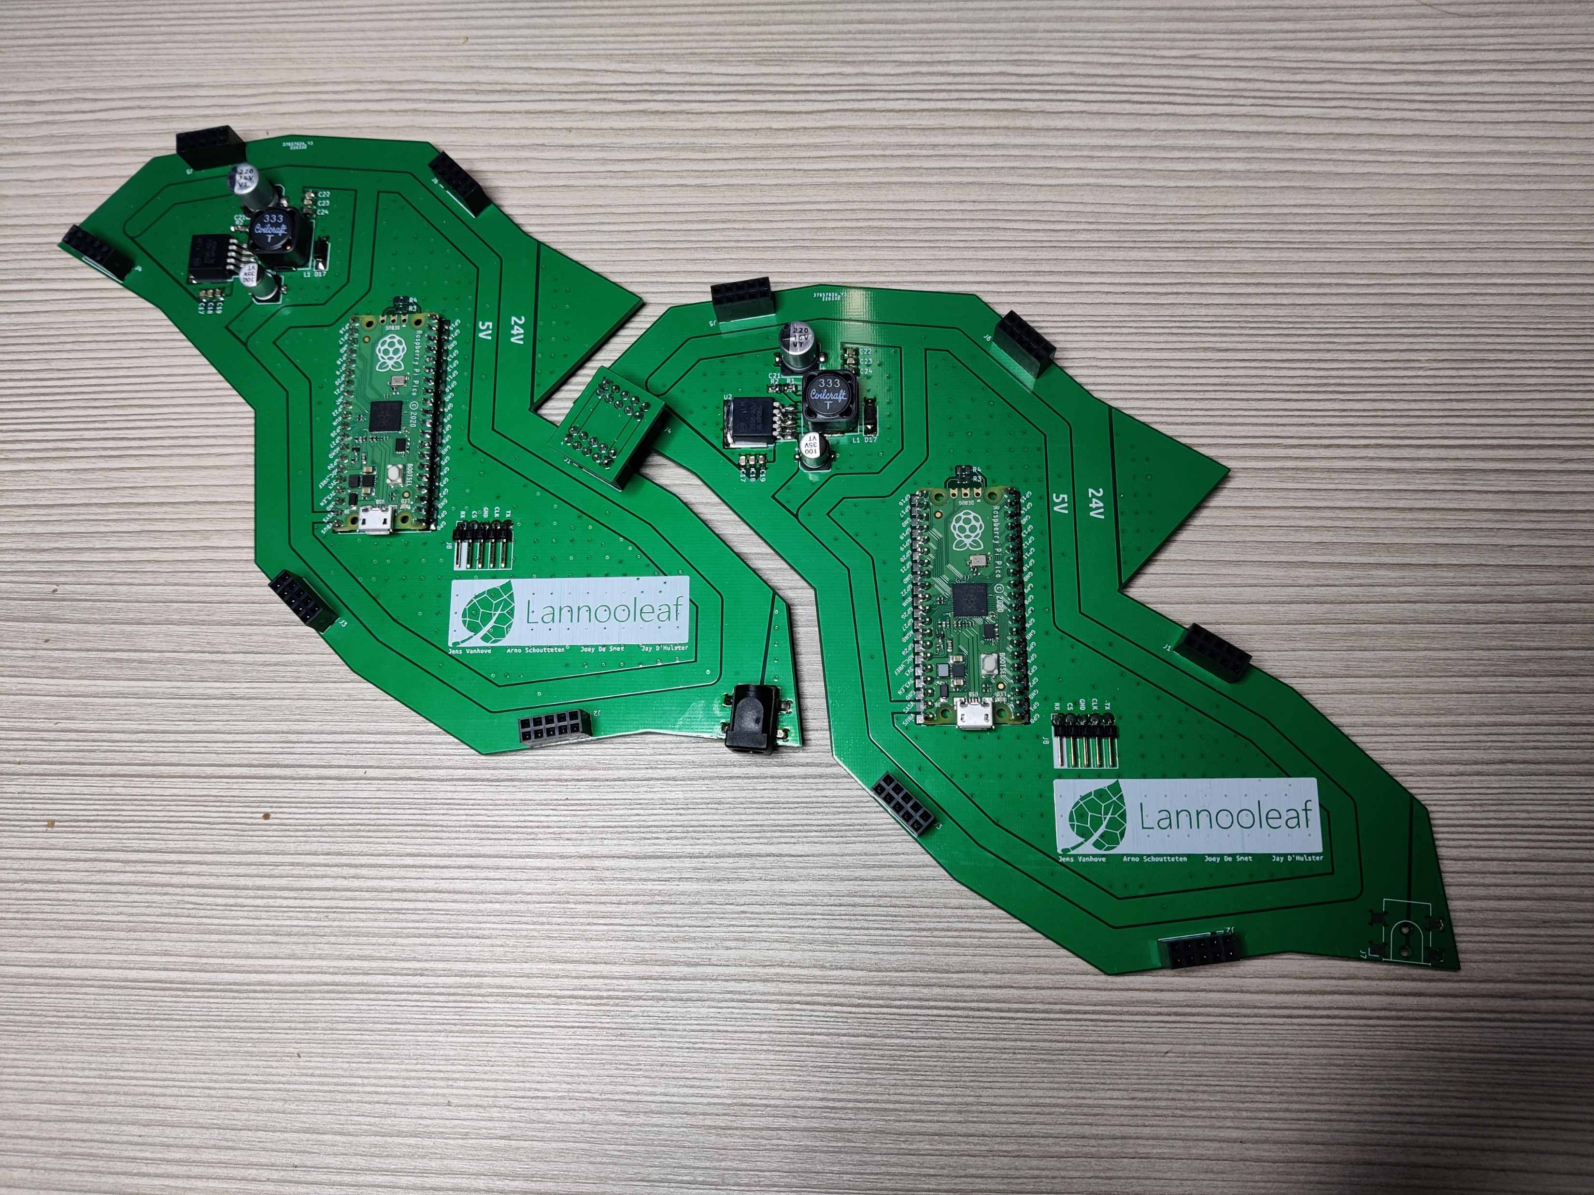
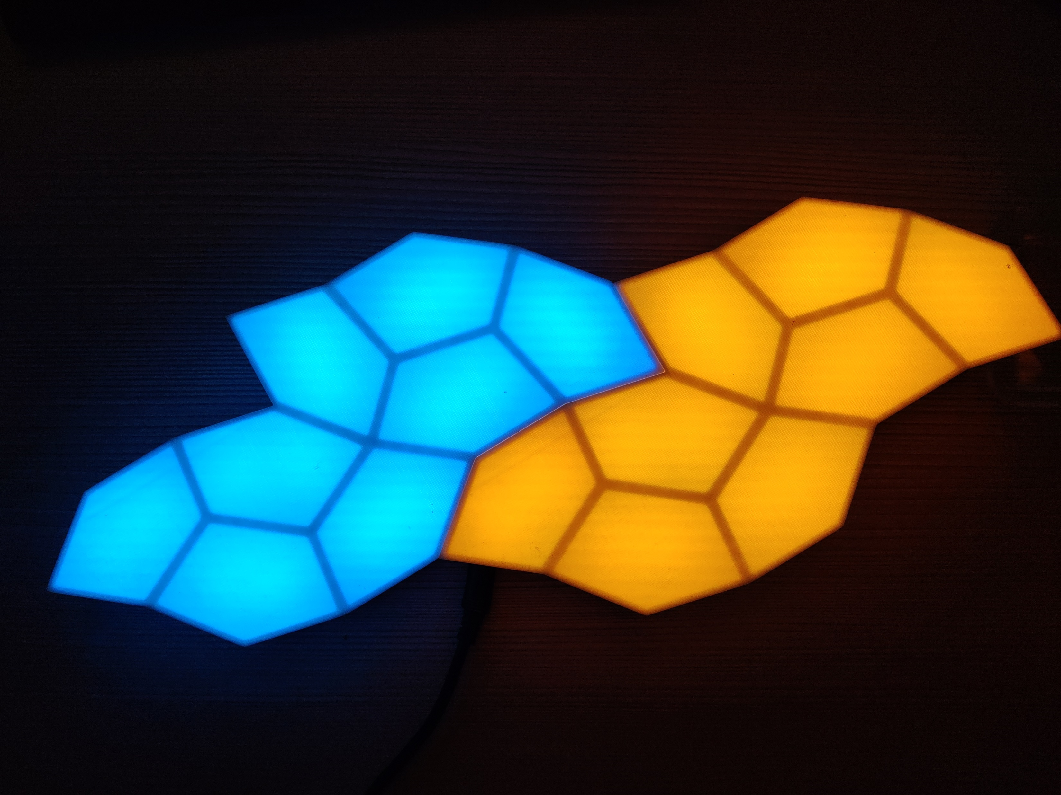
Lannooleaf
Achieved work
3D printed shape
PCB design & soldering
Unit discovery
SPI communication controller -> Raspberry Pi
I2C on 1Mbps
Frontend webapp
LannooLeaf npm package
Websocket
Precalculating pixelmapping
Interpolation
Gamma correction
Image and gif mapping
New shape variant

Slide 4
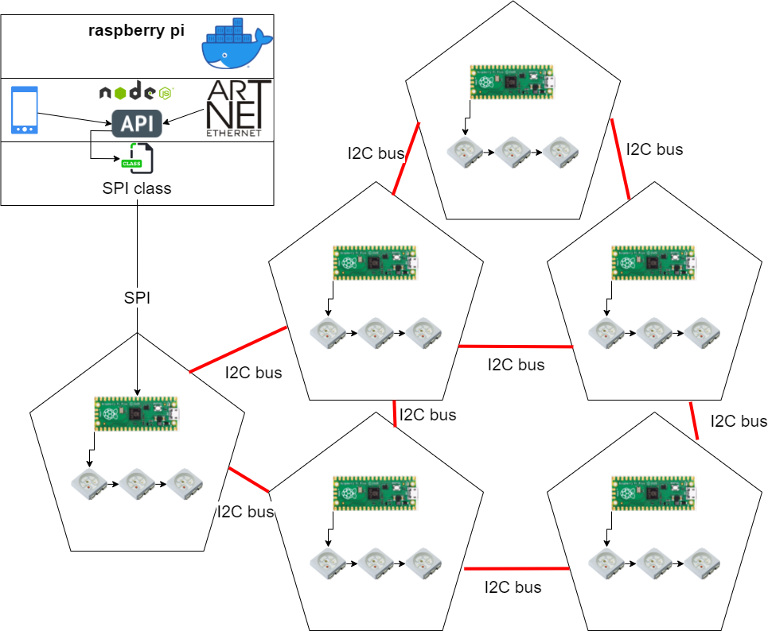
Lannooleaf
Communication

Slide 5
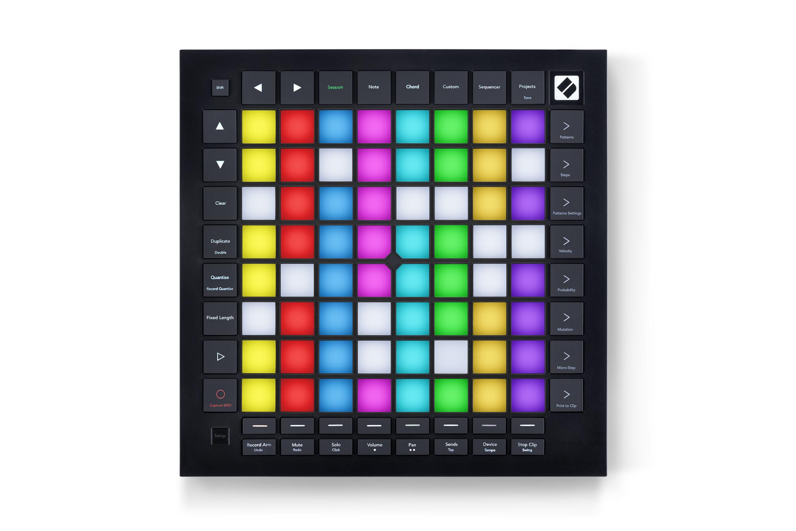

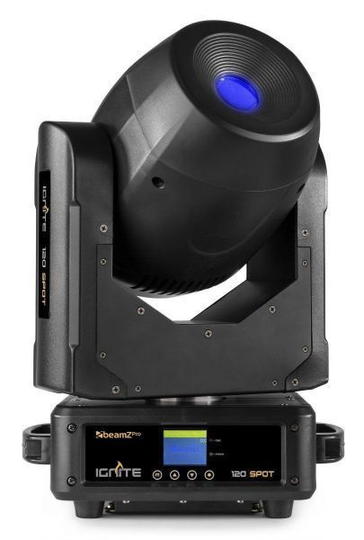
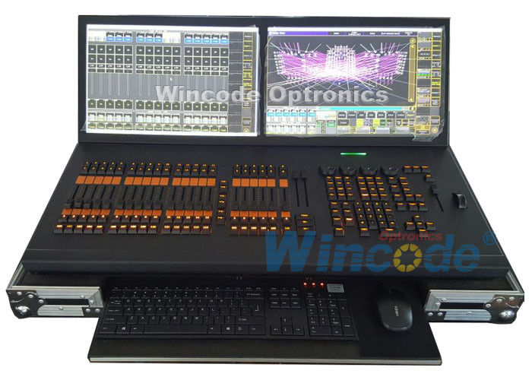
Lannooleaf
Future Work
Websocket and API connection
API calls interpolation script
Artnet mapping
Feedback to frontend

